Slide 1
Windows Containers
Taylor.Brown@microsoft.com
@taylorb_msft
Principal Lead PM
Windows Server Developer Strategy

Slide 2
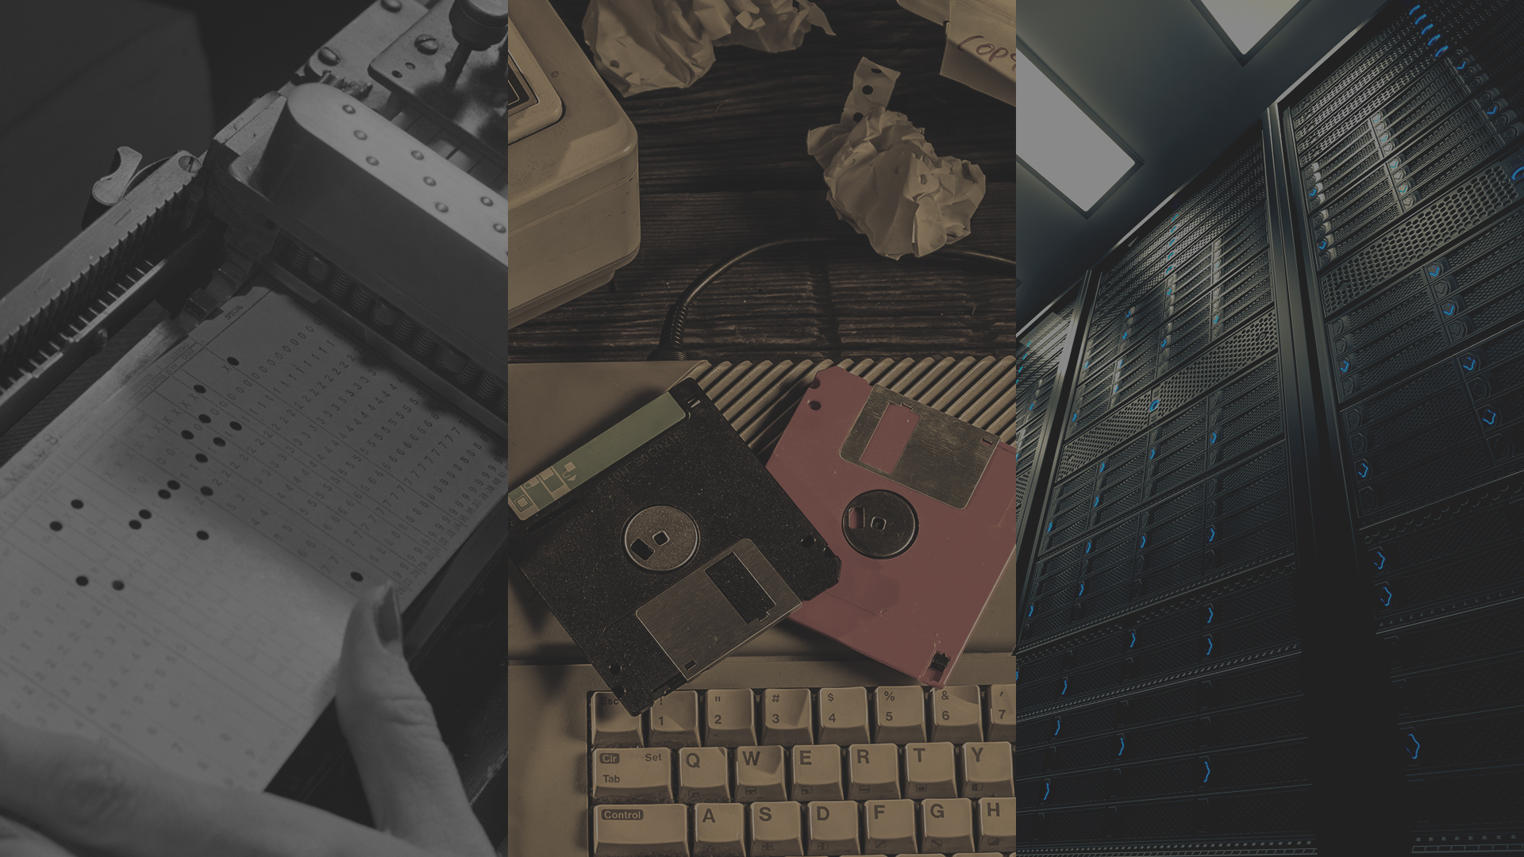
Works on my machine
Set of IT Problems forever
Patches break installations
Deployment binders
Lead to shadow IT, tension between dev/ops
Etc

Slide 3




The cloud has changed expectations
Availability
100% Uptime
Hyper-scale
From startup to enterprise
Agility
Deliver just in time speed
http://www.gettyimages.com/detail/photo/cloud-computing-and-communications-technology-royalty-free-image/145671614
Notes:
Change happens every day. New Acquisitions, New Industries, New Opportunities
The early bird gets the worm

Slide 4
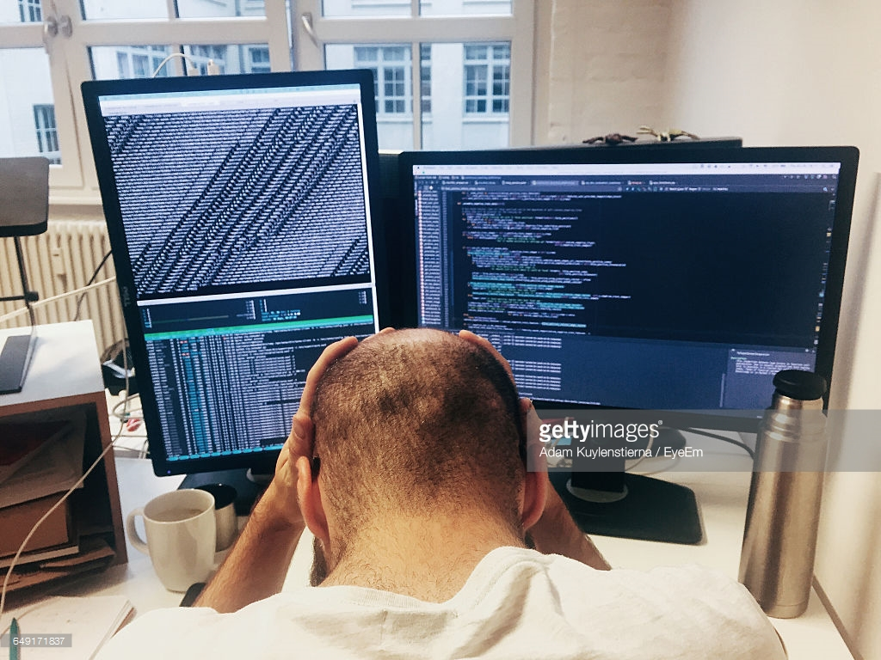
Where do developers spend time…
Maintaining existing applications
“Fixing” existing applications
Adding features to existing applications
Fixing the feature someone else added to the existing applications
Building a new application (maybe… if there’s time)

Slide 5
Where do application admin’s spend time…
Maintaining existing applications
Re-deploying new versions
of existing applications
Diagnosing issues with
existing applications
Troubleshooting issues from feature additions to the existing applications
Building a new application (maybe… if there’s time)

Slide 6
What problems do containers solve?
Notes:
5 MIN

Slide 7

Containers deliver speed, flexibility, and savings
Availability
Hyper-scale
Agility
62%
Report reduction in MTTR
41%
Move workloads across private/public clouds
13X
More software releases
10X
Cost reduction in maintaining existing applications
65%
Reduction in developer onboarding time
Eliminate
“works on my machine” issues
State of App development Survey: Q1 2016, Cornell University case study
Notes:
The Docker CaaS platform delivers these benefits for organizations and is already proven by the thousands of organizations who embarked on the Docker journey starting in 2013
Agility – The speed and simplicity of Docker is what originally drew developers to Docker. They were fundamentally able to ship more software faster. This fundamentally changed the way in which companies could innovate
- ING went from shipping once every 9 months to shipping over 1,500 times a year by adoption Docker and DevOps
- CapitalOne was able to use Docker to transform how they use data to empower their data scientists and business decisions.
Portability – Just by the nature of the Docker technology, these developers realized they could easily move that containerized app from dev to test and ultimately to prod without any issue. No more finger pointing about why the app that worked fine in dev doesn’t work in prod. Having the app and dependencies packaged together made the container a self contained and independent unit. And beyond that, teams realized they could also move these apps across data centers and clouds – giving them a level of freedom and leverage not possible before. No more lock-in.
The combination of agility and portability led to the #1 most popular use case for Docker – Continuous Integration. But that’s only half the value. To realize the full value of Docker, these apps need to move to production and new requirements around manageability, security and monitoring are required to enforce SLAs.
Control – The Docker platform is the only solution that provides Agility AND Portability AND Control.
Docker standardizes your application environment, with native tooling to manage the infrastructure and applications. And we provide you the levers so YOU can decide how much control and freedom is appropriate for YOUR business. We don’t prescribe that for you. Our tools help unify your heterogeneous infrastructure, languages and systems.

Slide 8
Customer Success
Northern Trust
4x Faster Deployment Times, 2x Improvement in infrastructure utilization
Microsoft IT
10 Apps; 4x Density improvement; 1/3 infrastructure cost
Yet to be named transportation provider
20% faster response times for customers
Deployment went from Weeks to Days
In production for several month
Tyco
Went into production before Windows Server was GA
“By using Windows Server Containers and Docker, we can remove the scalability limits on this critical application by adopting a microservices architecture. This will enable us to sell and support more devices, which is important as our customer base expands and large customers add new facilities.“ -Stephen Tarmey : Chief Architect Tyco
Notes:
Northern Trust:
- 29 day deployment times down to 7 days

Slide 9
What is a container?
Notes:
9 MIN

Slide 10



Virtual Machine (VM) vs. Container
Notes:
Helpful to reflect on history a bit. Apps install on OS, OS installs on hardware.
Need to add a second house (build) and separate plumbing, electricity
Single unit, self-contained
Own utilities, water heater, etc.
Own front door, etc.
Want another house, build another house

Slide 11
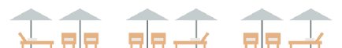



Virtual Machine (VM) vs. Container
Notes:
Helpful to reflect on history a bit. Apps install on OS, OS installs on hardware.
Need to add a second house (build) and separate plumbing, electricity
Single unit, self-contained
Own utilities, water heater, etc.
Own front door, etc.
Want another house, build another house

Slide 12
Virtual Machine (VM) vs. Container
Notes:
Helpful to reflect on history a bit. Apps install on OS, OS installs on hardware.
Need to add a second house (build) and separate plumbing, electricity
Single unit, self-contained
Own utilities, water heater, etc.
Own front door, etc.
Want another house, build another house

Slide 13
How do containers work?
Notes:
12 MIN

Slide 14
High Level Architecture
}
Docker Universal Control Plane
Container
Development and
Management Toolset
Docker CLI and PowerShell
Docker
Swarm and Compose
Docker Image Registries
Microsoft Service Fabric
Kubernetes
Docker Engine
Operating System
Container Runtime

Slide 15
Windows Containers
Host User Mode
System Processes
Session Manager
Container Management
Local Security Authority
Docker Engine
Etc…
Windows Kernel

Slide 16
Windows Containers
Host User Mode
System Processes
Session Manager
Container Management
Local Security Authority
Windows Server Container
Docker Engine
Etc…
Windows Kernel

Slide 17
Windows Containers
Host User Mode
System Processes
Session Manager
Container Management
Local Security Authority
Windows Server Container
Docker Engine
Etc…
System Processes
Windows Kernel

Slide 18
Windows Containers
Host User Mode
System Processes
Session Manager
Container Management
Local Security Authority
Windows Server Container
Docker Engine
Etc…
System Processes
Application Process(es)
Windows Kernel

Slide 19
Windows Containers
Host User Mode
System Processes
Session Manager
Container Management
Local Security Authority
Windows Server Container
Docker Engine
Etc…
System Processes
Application Process(es)
Windows Kernel

Slide 20
Windows Containers
Host User Mode
System Processes
Session Manager
Container Management
Local Security Authority
Windows Server Container
Windows Server Container
Docker Engine
Etc…
System Processes
Application Process(es)
System Processes
Application Process(es)
Windows Kernel

Slide 21
Windows Containers
Host User Mode
System Processes
Session Manager
Container Management
Local Security Authority
Windows Server Container
Windows Server Container
Docker Engine
Etc…
System Processes
Application Process(es)
System Processes
Application Process(es)
Windows Kernel
Windows Kernel
Hyper-V Hypervisor

Slide 22
Windows Containers
Host User Mode
System Processes
Virtual Machine Specifically Optimized To Run a Container
Session Manager
Container Management
Local Security Authority
Windows Server Container
Windows Server Container
Docker Engine
Etc…
System Processes
Application Process(es)
System Processes
Application Process(es)
Windows Kernel
Windows Kernel
Hyper-V Hypervisor

Slide 23
Windows Containers
Host User Mode
System Processes
Hyper-V Isolation
Virtual Machine Specifically Optimized To Run a Container
Session Manager
Container Management
Local Security Authority
Windows Server Container
Windows Server Container
Docker Engine
Etc…
System Processes
Application Process(es)
System Processes
Application Process(es)
Windows Kernel
Windows Kernel
Hyper-V Hypervisor

Slide 24
Windows Containers
Coming in Feature Release
Host User Mode
Hyper-V Isolation
Hyper-V Isolation
Container Runtime
Virtual Machine Specifically Optimized To Run a Container
Virtual Machine Specifically Optimized To Run a Container
Docker Engine
Windows Server Container
Windows Server Container
Linux
Container
containerD
System Processes
Application Process(es)
System Processes
Application Process(es)
System Processes
Application Process(es)
Windows Kernel
Windows Kernel
Linux Kernel
Hyper-V Hypervisor

Slide 25
Startup Performance
NodeJS with Nano Server
NodeJS with Windows Server Core
Hyper-V Container
~1.75 seconds
Windows Server Container
Under 600 Milliseconds!
With Hyper-V Isolation
~3.3 seconds
Windows Server Container
~1 second
A virtual machine takes ~3 seconds
A virtual machine takes ~5 seconds to over a min
*Includes initial boot provisioning phase (out-of-box setup etc…)
**Startup time after initial container start.
Testing performed on HP ProLiant SL250s Gen8, E5-2600, 2 Socket, 8 Core, 128GB RAM, HP SATA SSD - results may vary based on hardware and software configurations.
Notes:
Server Core
Win Srv Ctr = 1sec
Hyper-V Ctr – 3.3sec
VM = 5sec – over 1 min

Slide 26
Startup Performance
NodeJS with Nano Server
Windows Server Container
Under 600 Milliseconds!
With Hyper-V Isolation
~1.75 seconds
A virtual machine takes ~3 seconds
NodeJS with Windows Server Core
Windows Server Container
~1 second
With Hyper-V Isolation
~3.3 seconds
A virtual machine takes ~5 seconds to over a min
Notes:
Nano Server
Win Srv Ctr = Under 600ms (closer to 550ms)
Hyper-V Ctr – 1.75sec (clone)
VM = 3 sec

Slide 27
Density
NodeJS with Nano Server
NodeJS with Windows Server Core
Hyper-V Container
First Container ~340MB
Additional Containers ~150MB
Windows Server Container
First Container ~120MB
Additional Containers ~75MB
With Hyper-V Isolation
First Container ~555MB
Additional Containers ~280MB
Windows Server Container
First Container ~150MB
Additional Containers ~75MB
Testing performed on HP ProLiant SL250s Gen8, E5-2600, 2 Socket, 8 Core, 128GB RAM, HP SATA SSD - results may vary based on hardware and software configurations.
Notes:
Server Core
Win Srv Ctr = first 150MB; additional 75MB
Hyper-V Ctr = first 555MB; additional 280MB

Slide 28
Density
NodeJS with Nano Server
Windows Server Container
First Container ~120MB
Additional Containers ~75MB
With Hyper-V Isolation
First Container ~340MB
Additional Containers ~150MB
NodeJS with Windows Server Core
Windows Server Container
First Container ~150MB
Additional Containers ~75MB
With Hyper-V Isolation
First Container ~555MB
Additional Containers ~280MB
Notes:
Nano
Win Srv Ctr = first 120MB; additional 75MB
Hyper-V Ctr = first 340MB; additional 150MB

Slide 29
Where should I start?
Notes:
12 MIN

Slide 30

One platform, one journey
CONTAINERIZE TRADITIONAL APPLICATIONS
Containerize for security, portability and efficiency
TRANSFORM MONOLITHIC TO MICROSERVICES
Look for shared services to transform
ACCELERATE NEW APPLICATIONS
Agile cloud native app development

Slide 31
Why containerize traditional Windows apps?
Top Development Challenges for Development Teams
PORTABILITY, SECURITY AND COST REDUCTION
Accelerate your public and hybrid cloud strategy
Gain applications portability, agility, and control
Reduce infrastructure and management costs for Windows 2003, 2008, and 2012 Windows applications
65%
Traditional Application Maintenance
59%
Inertia of Traditional App Infrastructure
Application Maintenance and Management
COSTS FOR MANAGING TRADITIONAL APPLICATIONS
Custom Licensing and Support
Security
risk
Hardware Resources Inefficiencies
State of App development Survey: Q1 2016, Cornell University case study.
Notes:
Need more qualifiers here for the actual license and opex saving for migrating legacy Windows apps to Windows 2016
Getting ready for cloud
Deployment – how can I give an app that a customer can deploy consistency

Slide 32
“
Most of our application portfolio consists of older legacy applications that are cumbersome to update. By moving these applications into Windows Server Containers with Docker and embracing a microservices architecture, we can break these big applications apart and update the pieces independently. This will reduce customer downtime and increase business agility.
“
STEPHEN TARMEY Chief Architect
Tyco International

Slide 33



Collaborative DevOps Approach to apps
Docker containers are central to process
OPERATIONS collaborates with DEVELOPERS to provide app metrics and insights.
DEVELOPERS build, test and update apps in Docker containers, using development environment, i.e., Visual Studio.
OPERATIONS automates deployment and monitors deployed apps from central Docker container repository.
DEVELOPERS push containers to central repository.
Notes:
TODO: connect with Dev Tools on lifecycle all the way to Azure
So what does a lifecycle look like?
Firstly, developers build and test their applications, in containers, on their own box. This could be using a development environment like Visual Studio, or one from a 3rd party. You’ll see in this case, there is a couple of different containers, perhaps representing 2 tiers of an application or workload.
Once completed, these containers are pushed to central repository. This could be a Docker repository, which you’ll learn more about later.
Operations automates deployment of the containers, from this central repository, to the target machines, which could be physical or virtual. They continue to monitor the containers…
…and collaborate with developers to provide them with insight and monitoring metrics which help the development teams gain insight into the usage of the applications.
This could be used to drive an update to a particular container, which, with the developers perform on their own boxes, iterate a version, and deploy the updated version to the central repository, which in turn, is then used to update the existing deployed containers. They could also, if they wanted, to roll it back to a previous version. Containers provides considerable flexibility in this space.

Slide 34
How do I actually create a container?
Notes:
20 MIN

Slide 35
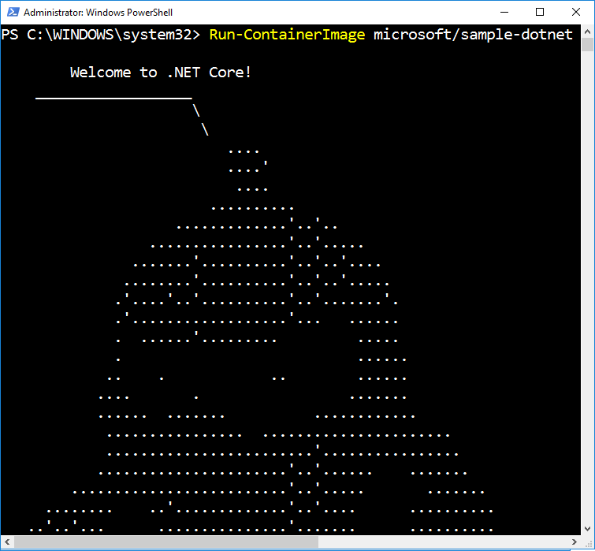
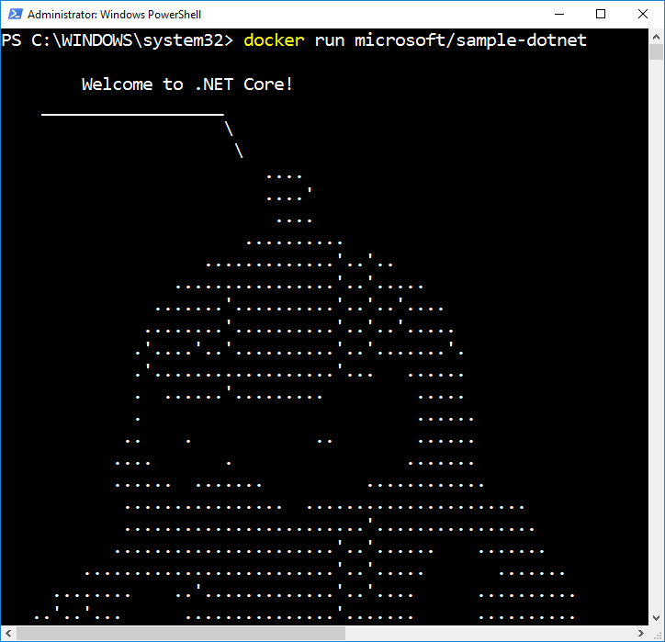
Docker Run
Creates and Starts a New Container
Runtime options
Name (network name and management name)
Interactive or Service
Network configuration
Resource management
Volume mappings
Isolation level
Notes:
It would be easy to demo both docker run & powershell side by side. We don’t have a lot of time to go into details but its probably worth a mention with live demo here

Slide 36
What is a container image?
Notes:
23 MIN

Slide 37

Container Image
Analogous to a VHD and config file to a virtual machine
Created by running a container and capturing changes
Changes include files and registry
Image
Metadata Name,
Creation Data,
Command To Execute,
Dependences
Contents
Registry
Files
Folders

Slide 38
Container Images
My Website
Application
IIS
Application Framework
Base Image (OS)

Slide 39
Container Images
My Website
Application
IIS
Application Framework
Image Contents
Registry
Folders and Files
HKLM
HKCU
License.txt
PerfLogs
Program Files
Base Image (OS)
HKCR
HKU
Program Files (x86)
Users
Windows

Slide 40
Container Images
Image Contents
Registry
Folders and Files
My Website
Application
HKLM
inetpub
mysite.html
IIS
SOFTWARE/mykey
Application Framework
Image Contents
Registry
Folders and Files
HKLM
HKCU
License.txt
PerfLogs
Program Files
Base Image (OS)
HKCR
HKU
Program Files (x86)
Users
Windows

Slide 41
Automated Image Building
Docker Build and Dockerfiles
Method for automated container image build
Consumed when running “docker build”
Caches unchanged commands
Integrates into Docker Hub
Examples
IIS
FROM windowsservercore
RUN powershell –command Add-WindowsFeature Web-Server
Website
FROM iis
ADD mysite.htm inetpub\mysite.htm
My Website
IIS

Slide 42
Image Registries
What is a registry?
Stores container images
Images are Pushed into a registry
Images are Pulled from a registry
Images are Searched for within a registry

Slide 43
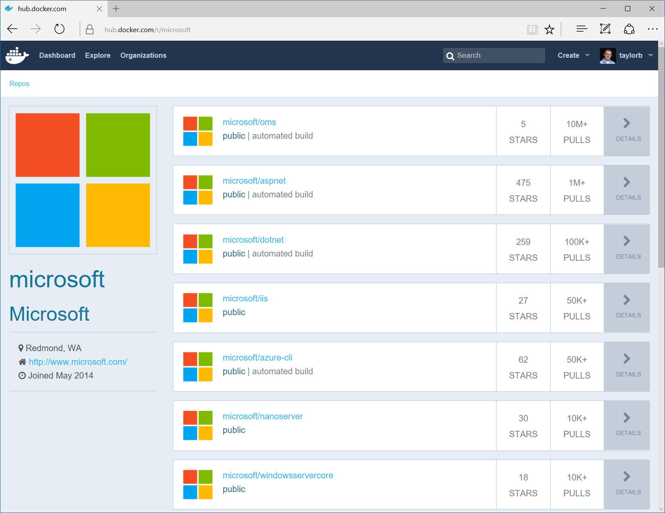
Image Registries
Docker Hub and Docker Store
Public, Official and Private image repositories
Granular access controls with organization support
Automated image build support
Docker Trusted Registry
Enterprise Grade Private Registries
Runs on your infrastructure (on-prem or cloud)
Active Directory and Role Based Access Controls
Azure Container Registry
Store and manage container images across Azure deployments
Maintain Windows and Linux container images
Same API and Tools as Docker Hub/Store/Registry
Docker Registry
Open source foundation of Hub and DTR
Runs on your infrastructure (on-prem or cloud) as a container
https://docs.docker.com/registry and or https://github.com/docker/distribution

Slide 44
What about…
Notes:
35 MIN

Slide 45
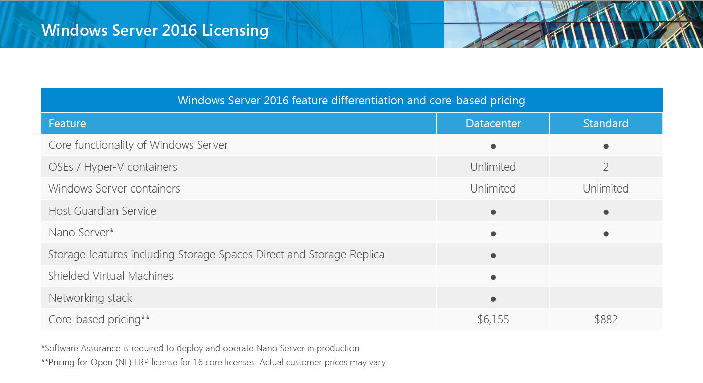
Licensing
https://www.microsoft.com/en-us/cloud-platform/windows-server-pricing

Slide 46
Patching and Updates
Update Container OS Image
Pull updated base image
Rebuild containers using dockerfiles
My Website
IIS
10.0.14393.0

Slide 47
Patching and Updates
Update Container OS Image
Pull updated base image
Rebuild containers using dockerfiles
My Website
IIS
10.0.14393.0

Slide 48
Patching and Updates
Update Container OS Image
Pull updated base image
Rebuild containers using dockerfiles
My Website
IIS
KB123456 = new image on Docker Hub
10.0.14393.0
10.0.14393.1

Slide 49
Patching and Updates
Update Container OS Image
Pull updated base image
Rebuild containers using dockerfiles
My Website
IIS
IIS
FROM windowsservercore
RUN powershell –command Add-WindowsFeature Web-Server
KB123456 = new image on Docker Hub
10.0.14393.0
10.0.14393.1

Slide 50
Patching and Updates
Update Container OS Image
Pull updated base image
Rebuild containers using dockerfiles
My Website
My Website
FROM iis
ADD mysite.htm inetpub\mysite.htm
IIS
IIS
FROM windowsservercore
RUN powershell –command Add-WindowsFeature Web-Server
KB123456 = new image on Docker Hub
10.0.14393.0
10.0.14393.1

Slide 51
Patching and Updates
Update as a new layer
Download update in container (ala run Windows Update in the container)
When container is stopped update is applied as a new layer
My Website
IIS
10.0.14393.0

Slide 52
Patching and Updates
Update as a new layer
Download update in container (ala run Windows Update in the container)
When container is stopped update is applied as a new layer
My Website
IIS
10.0.14393.0

Slide 53
Patching and Updates
Update as a new layer
Download update in container (ala run Windows Update in the container)
When container is stopped update is applied as a new layer
My Website
IIS
Same Image
10.0.14393.0
10.0.14393.0

Slide 54
Patching and Updates
Update as a new layer
Download update in container (ala run Windows Update in the container)
When container is stopped update is applied as a new layer
My Website
My Website
Same Image
IIS
IIS
Same Image
Same Image
10.0.14393.0
10.0.14393.0

Slide 55
Patching and Updates
Update as a new layer
Download update in container (ala run Windows Update in the container)
When container is stopped update is applied as a new layer
KB123456
My Website
My Website
Same Image
IIS
IIS
Same Image
Same Image
10.0.14393.0
10.0.14393.0
Notes:
40 MIN (after this slide)

Slide 56
Resource Controls
CPU
Percent of host CPU container can consume
Memory
Maximum memory container can consume
Disk
Maximum IO bandwidth on the system drive
Maximum IOPs limit on the system drive
Network
Platform support for egress caps

Slide 57
Networking
Fully Manageable with Docker
Network creation/enumeration
Service Discovery
Optimized for Microsoft Cloud Stack
Advanced network policy (ACLs, QoS) can be assigned per container endpoint
Load Balancing can be handled through the Microsoft Software Load Balancer (Coming Soon)
Area of Regular and Continuous Innovation
Docker tooling support (Compose) for networking (Limited Support at GA)
Integration with other Orchestrators (Kubernetes, Swarm, etc.)
Native Overlay network driver
Multiple networks (NAT and overlay) per host

Slide 58
Storage
Container Image
Not designed for persistent data
Not designed for secrets
“Volumes”
Enables storage persistence
Enables mapping of storage into containers
Read-Only or Read/Write
Multiple containers on the same host can access the same location
Plug-In Architecture
Network Storage
Containers access SMB shares
Accessed though the containers network

Slide 59
Volume Mapping
My Container
Container Host
Container Host

Slide 60
Volume Mapping
Image Contents
My Container
License.txt
PerfLogs
Program Files
Program Files (x86)
Users
Windows
Host Storage
C:
D:
Container Host
Container Host
ContainerData

Slide 61
Storage Volume Mapping Example
Running a Container
docker run –v d:\ContainerData:c:\data mycontiner
Image Contents
My Container
License.txt
PerfLogs
Program Files
Program Files (x86)
Users
Windows
Host Storage
C:
D:
Container Host
Container Host
ContainerData

Slide 62
Volume Mapping
Running a Container
docker run –v d:\ContainerData:c:\data mycontiner
Image Contents
My Container
License.txt
PerfLogs
Program Files
Container View
Program Files (x86)
Users
Windows
Host Storage
License.txt
PerfLogs
Program Files
C:
D:
Program Files (x86)
Users
Windows
data
Container Host
Container Host
ContainerData

Slide 63
Volume Mapping
Running a Container
docker run –v d:\ContainerData:c:\data mycontiner
Image Contents
My Container
License.txt
PerfLogs
Program Files
Container View
Program Files (x86)
Users
Windows
Host Storage
License.txt
PerfLogs
Program Files
C:
D:
Program Files (x86)
Users
Windows
data
Container Host
Container Host
ContainerData

Slide 64
Active Directory Identity for Containers
Ready for Enterprise Applications
No infrastructure changes to Active Directory required
Leverages Group Managed Service Accounts
Enables containerized applications to authenticate with SQL Server, file shares, and more
Simple and Secure
Identity specified at container start time
Credentials are not stored within the container image
No changes required to move across environments i.e. dev, test, prod, cloud

Slide 65

Active Directory Identity for Containers
1) Use default accounts for services & tasks (LocalSystem, Network Service)
Image
IIS & ASP.Net
Running Container
Service: IIS
User:
LocalSystem
SQL Server
Domain\MyWebApp1$
Credential Spec
DefaultAccount: Domain\MyWebApp1$
3) Container connects using service account
2) Provide default service account to use when starting container
Notes:
This has a build – read callouts in order

Slide 66
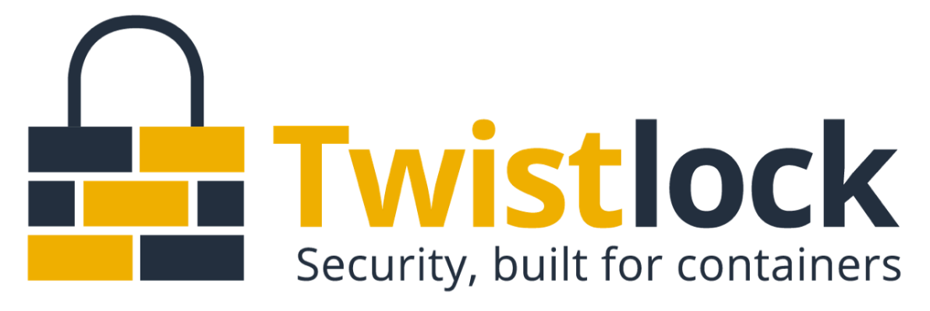
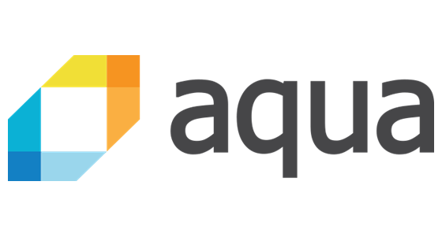
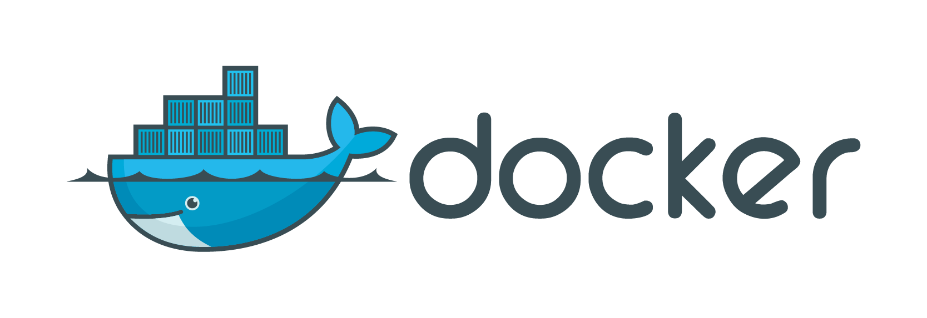
Secure Deployment and Auditing
Notes:
I’m still open to suggestions for slide title.
We shouldn’t imply that security is “missing” or go into a feature checklist so I want it to stay vague
“Two ecosystem players provide more granular security controls for deployment, management, vulnerability scanning, network policies, defense and auditing. Follow up with them to see demos and learn more about how they’re extending their capabilities across Windows & Linux, on-premises and in the cloud.”

Slide 67
Automation and Management
Notes:
56 MIN

Slide 68

Composition and Orchestration
Applications typically comprised of multiple containers
Containers typically hosted across a cluster of nodes
Orchestration tooling automates this

Slide 69
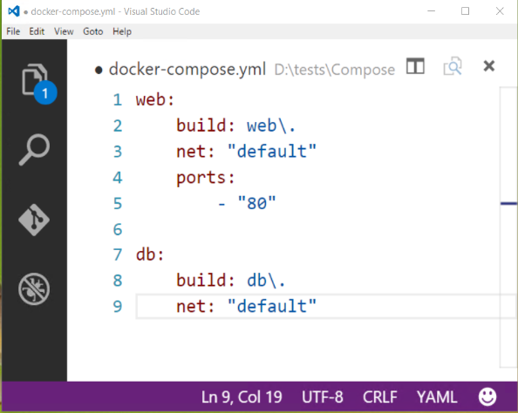

Composition and Orchestration
Docker Compose
Define application as separate containers
Manage different containers as a unit
Scale parts of application as needed
Docker Swarm
Aggregate container hosts
Supports tagging, affinity/anti-affinity

Slide 70
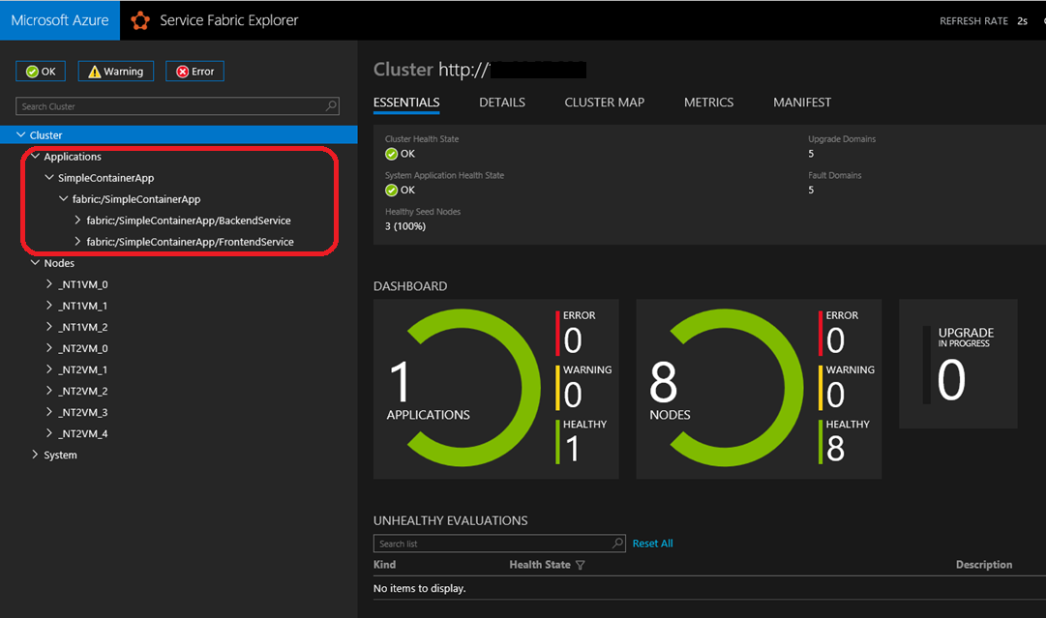

Composition and Orchestration
Azure Service Fabric
Microservice and orchestration platform
Build applications as containers and/or microservices
Available on Windows & Linux
Built-in cross-container communication
Web based management UI
Available On-Prem, Azure or other Clouds

Slide 71
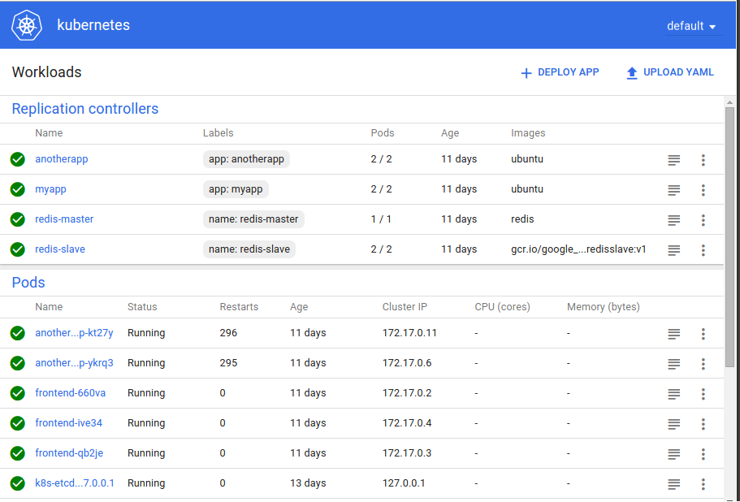
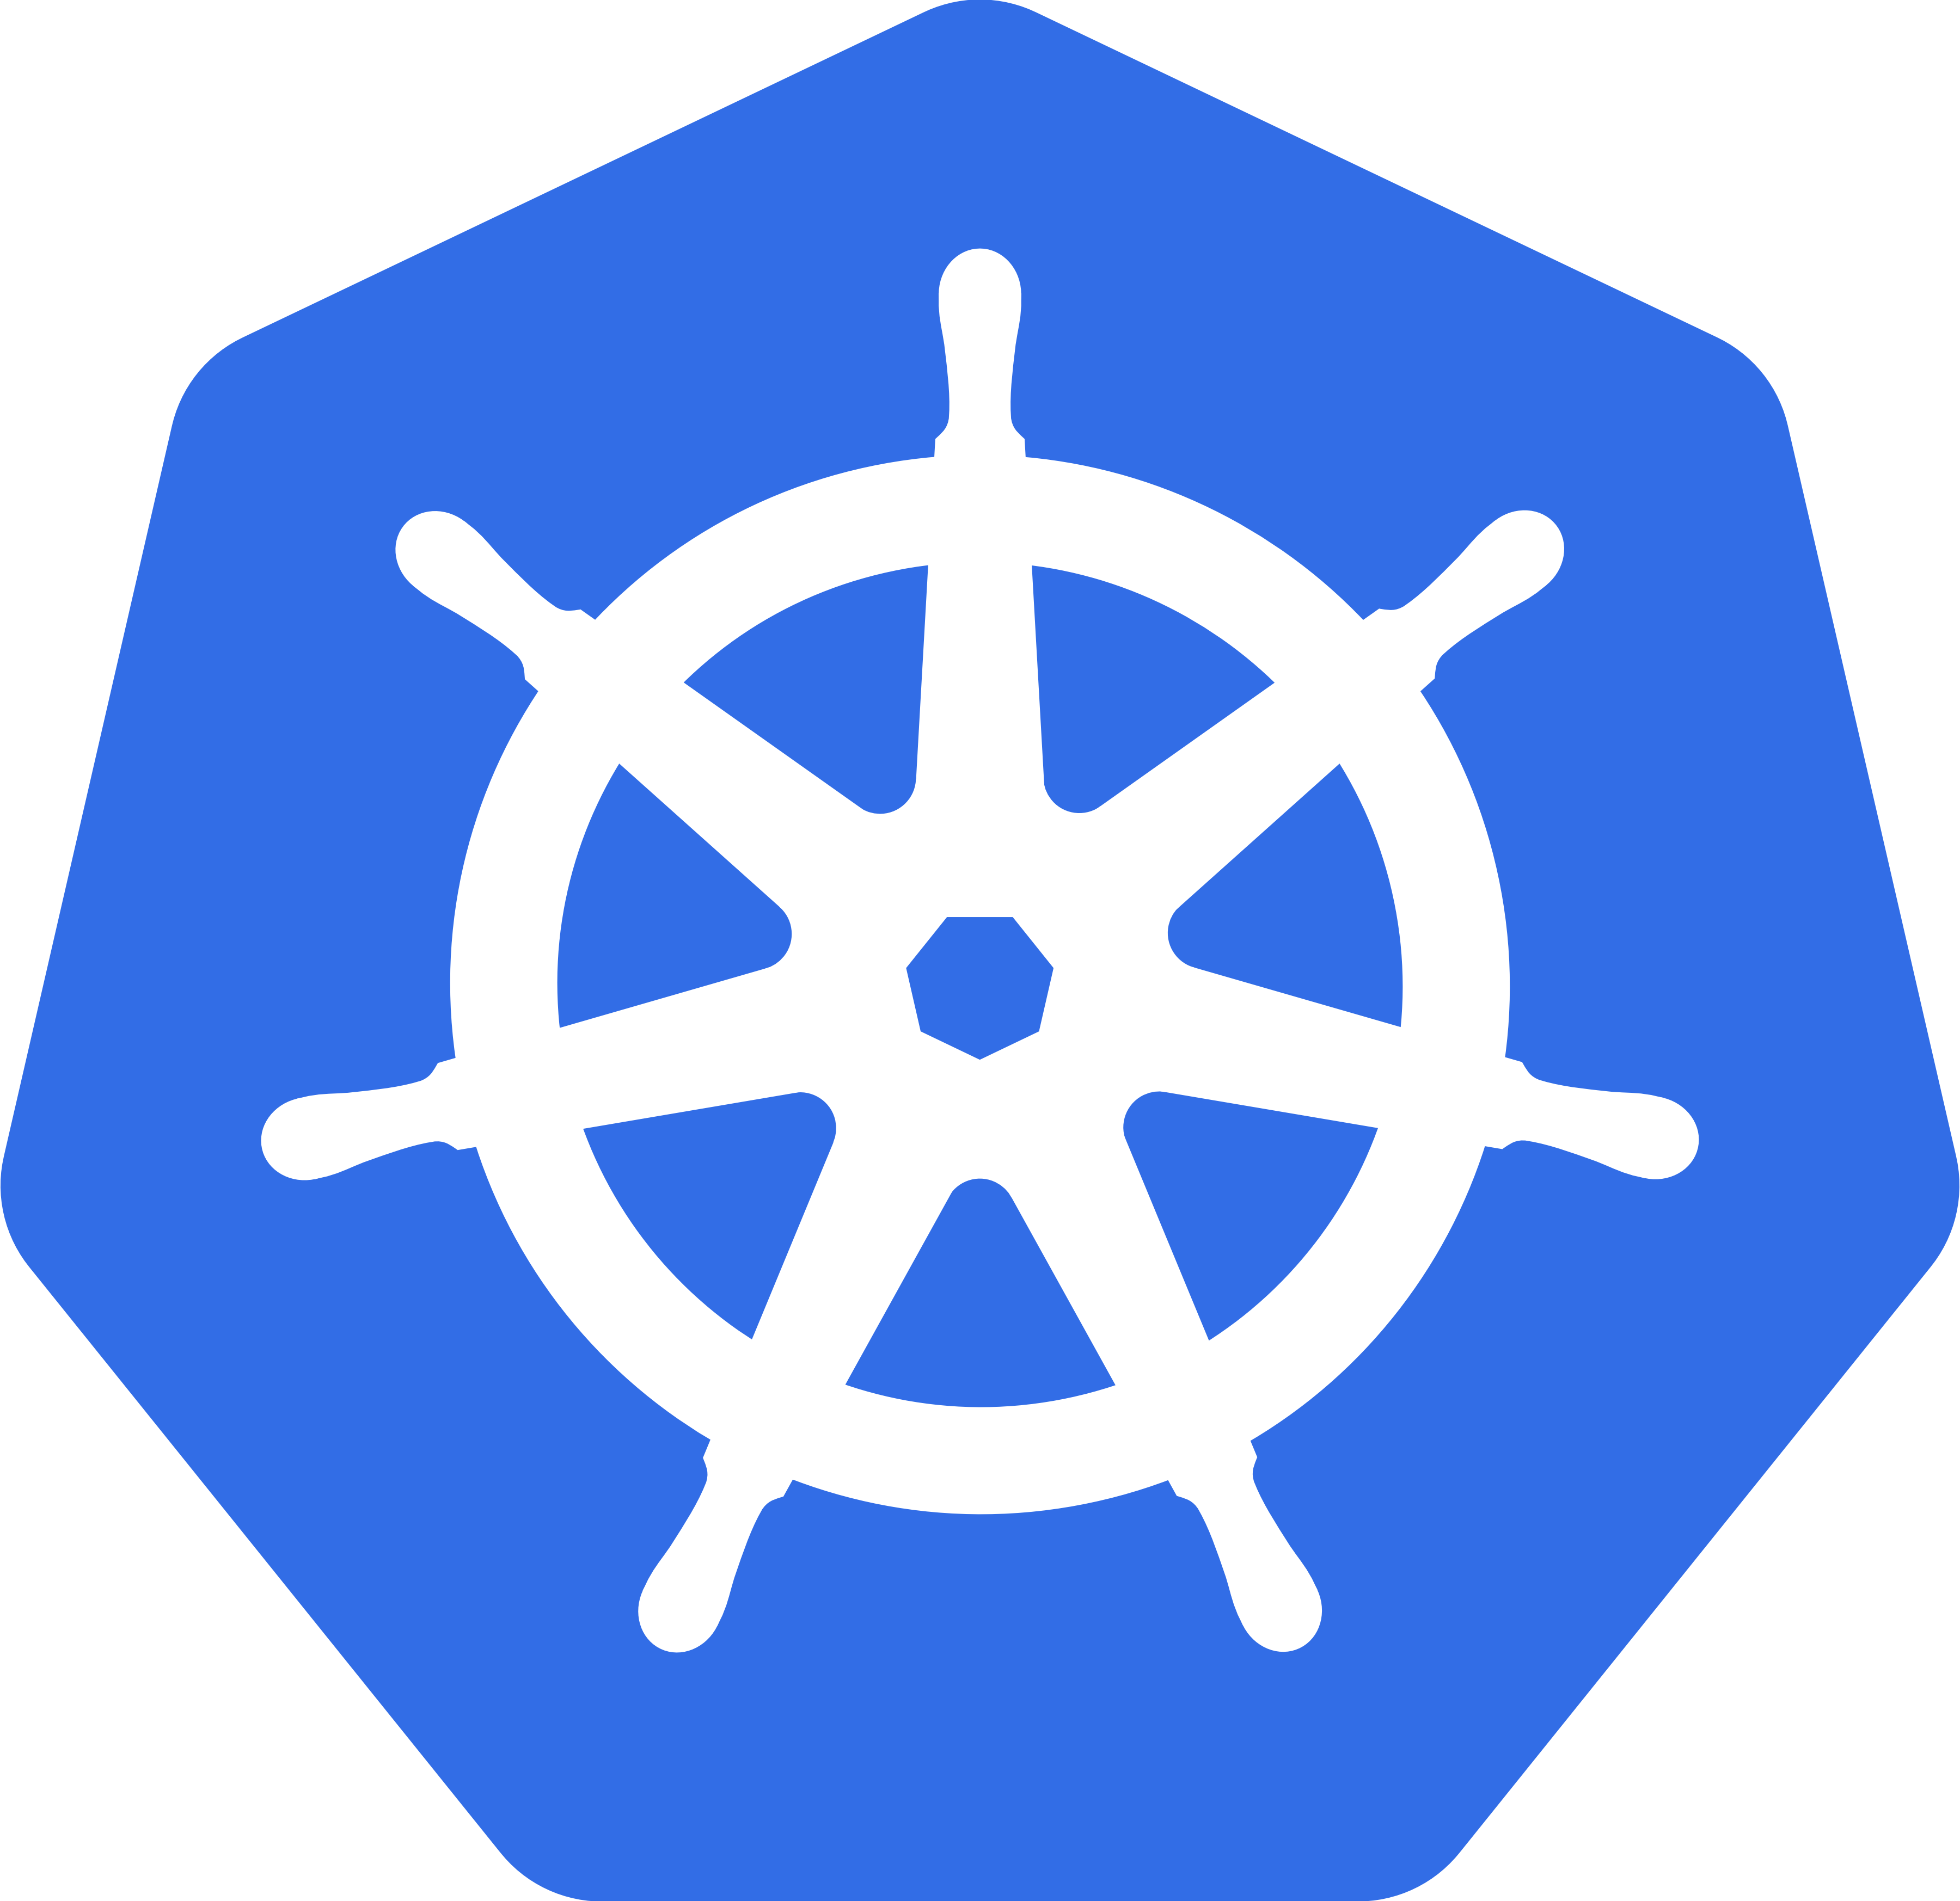
Composition and Orchestration
Kubernetes
Open source project started by Google
Windows support being added though community partnership spear headed by Apprenda

Slide 72
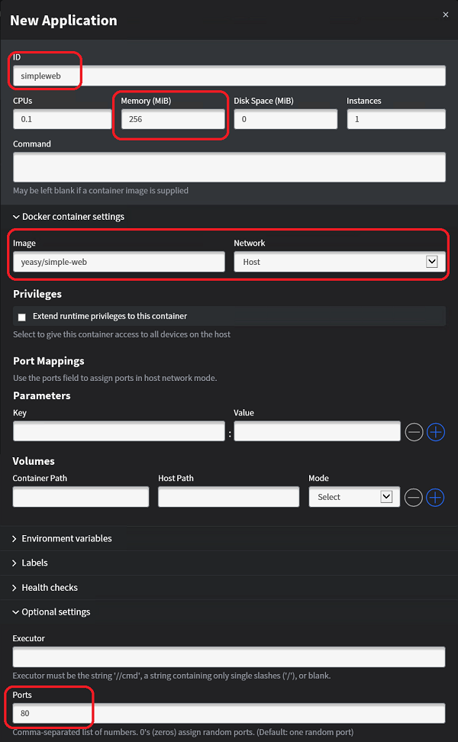

Composition and Orchestration
Mesos/Mesosphere + Marathon
Aggregates container hosts
Web based UI
Service Launch and Discovery

Slide 73
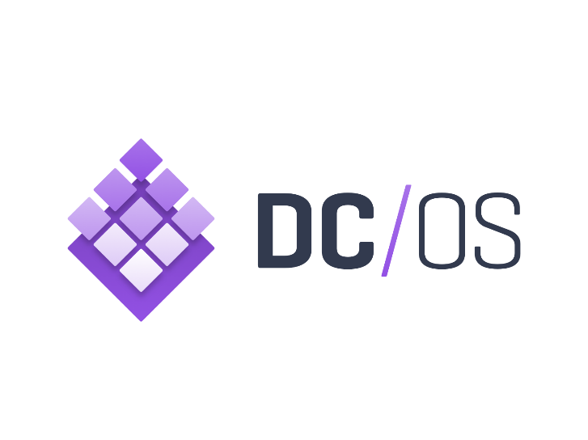

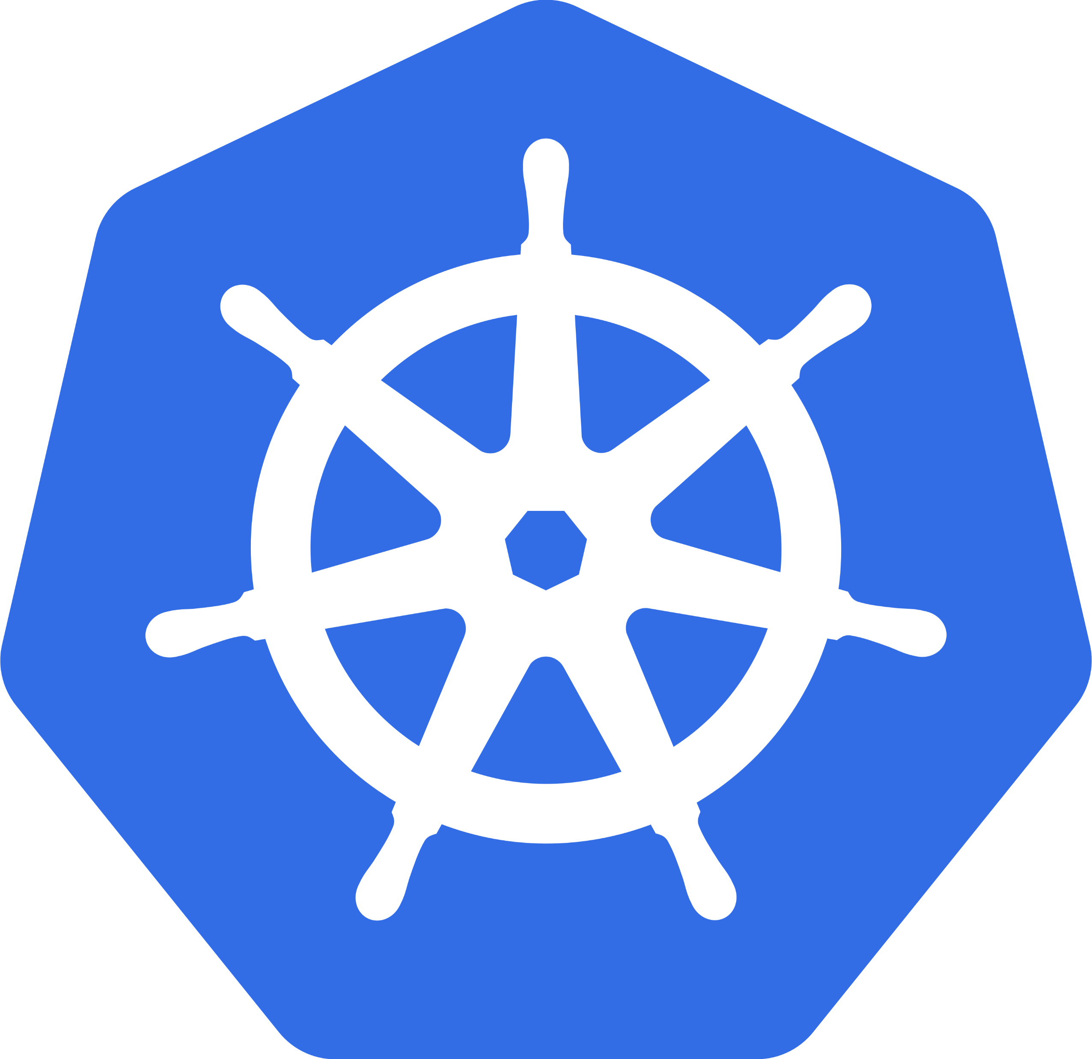
Azure Container Service
Choice of most popular container orchestrators
Simplest way to deploy open source container management platforms on Azure
Few clicks to enterprise grade container solution
<`/>
Container Registry
Container
Monitoring
DC/OS
Swarm
Command Line Interface
ARM templates
Windows &
Linux Containers
*Managed disks for
persistent storage
Kubernetes
Azure Portal
Notes:
Choice of most popular container orchestrators: Azure Container Service makes it simpler for you to create, configure, and manage a cluster of virtual machines that are preconfigured to run containerized applications. It uses an optimized configuration of popular open-source scheduling and orchestration tools. This enables you to use your existing skills, or draw upon a large and growing body of community expertise, to deploy and manage container-based applications on Microsoft Azure. Choose the tools and solution that best suits your needs for Docker container orchestration and scale operations. Use the Mesos-based DC/OS, Kubernetes, or use Docker Swarm and Compose for a pure Docker experience.
Simplest way to deploy containers on Azure: Azure Container Service provides rapid deployment of popular open-source container clustering and orchestration solutions. By using Azure Container Service, you can deploy DC/OS, Kubernetes, and Docker Swarm clusters with Azure Resource Manager templates or the Azure portal.
Few clicks to enterprise grade container solution: Azure Container Service optimizes the configuration of popular open source tools and technologies specifically for Azure. Work with the open source tools you know. Because we expose the standard API endpoints for our orchestration engine, you know the most popular tools will be compatible with Azure Container Service and, in most cases, will work out of the box—including visualizers, monitoring, continuous integration, command line tools, and even future tools as they become available.

Slide 74
Management and Monitoring Tools
Docker Datacenter
Docker Trusted Registry
Docker Universal Control Plane
Docker Swarm
Commercially Supported Docker Engines
Docker Engine
Docker Engine
Docker Engine
Docker Engine
Docker Engine
Compute
Private Cloud
Public Cloud

Slide 75
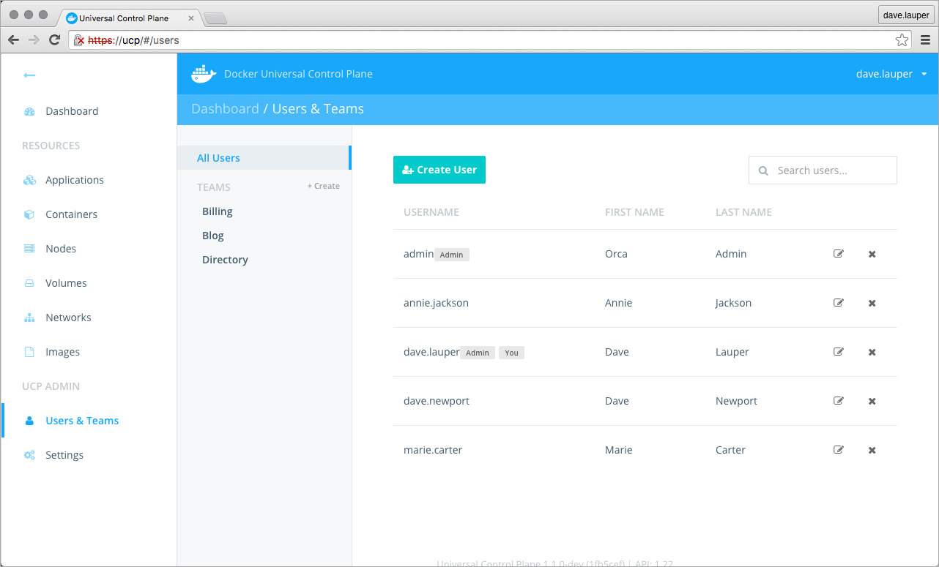
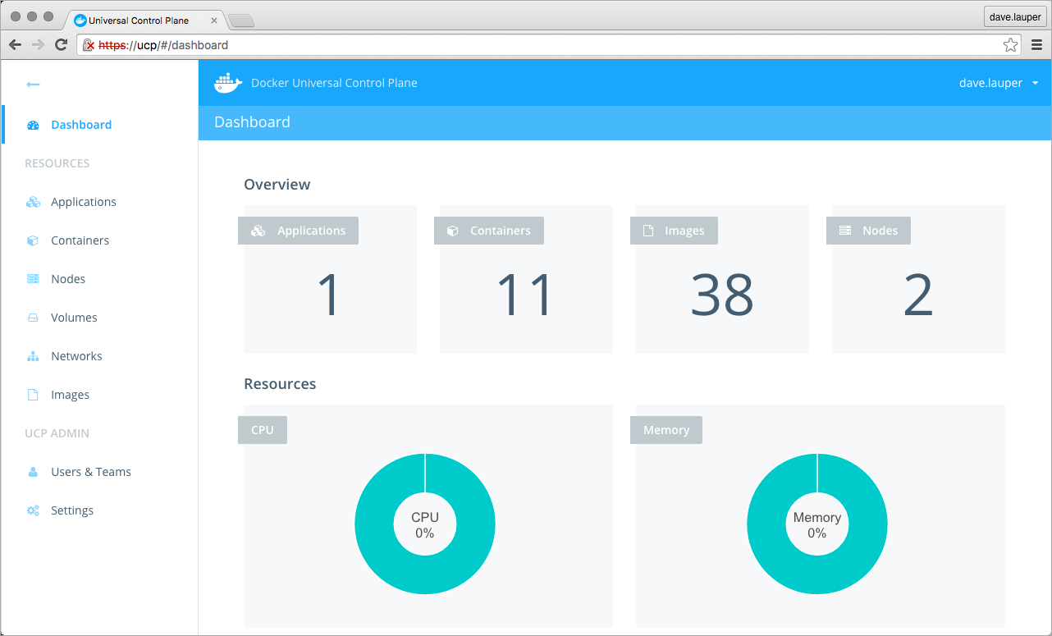
Management and Monitoring Tools
Docker Datacenter

Slide 76
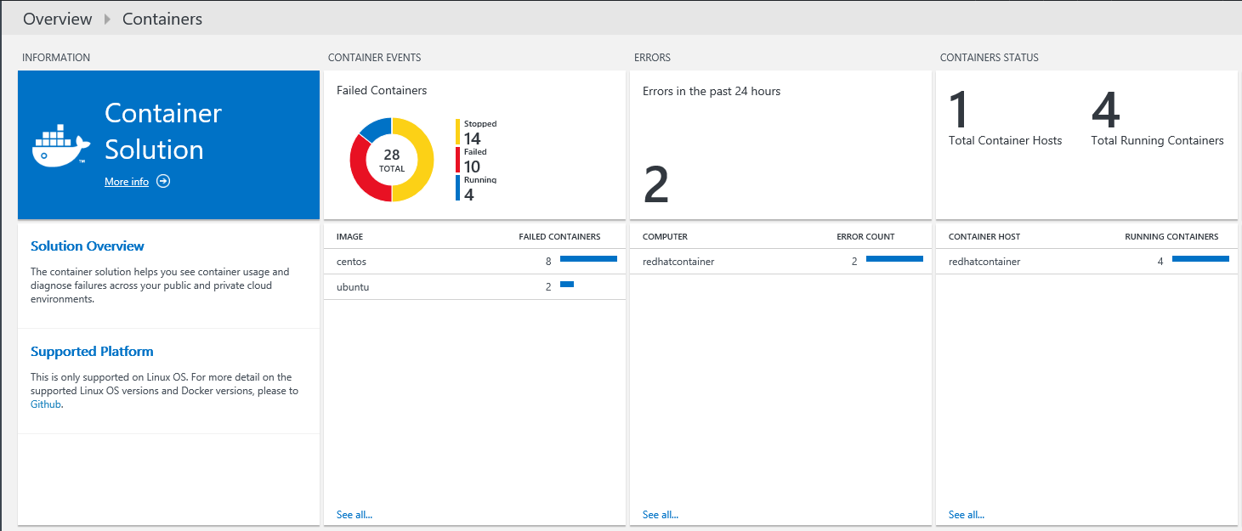
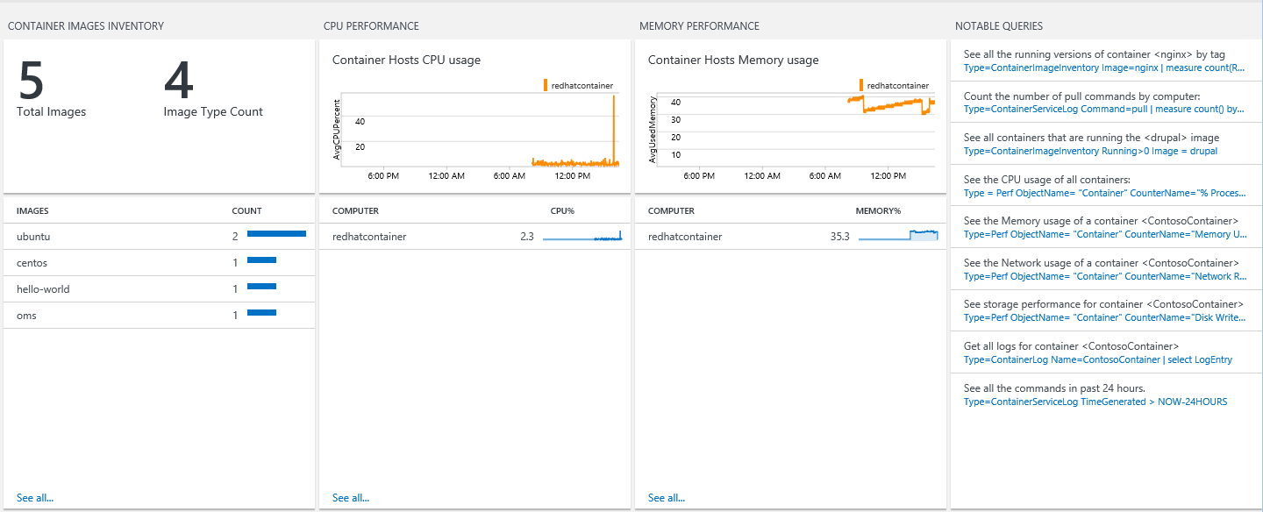
Microsoft Operations Management Suite
Monitoring Solution for Docker
Syslog events
Performance metrics
Container data

Slide 77
Development Tools
Notes:
68 MIN

Slide 78

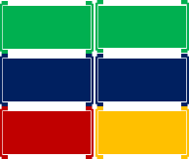
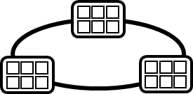
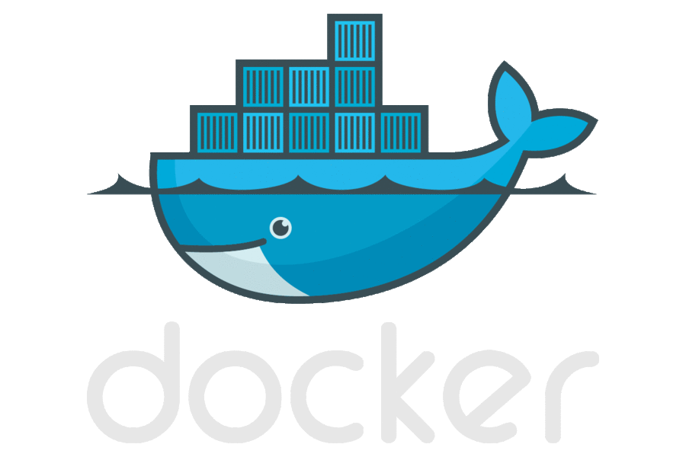



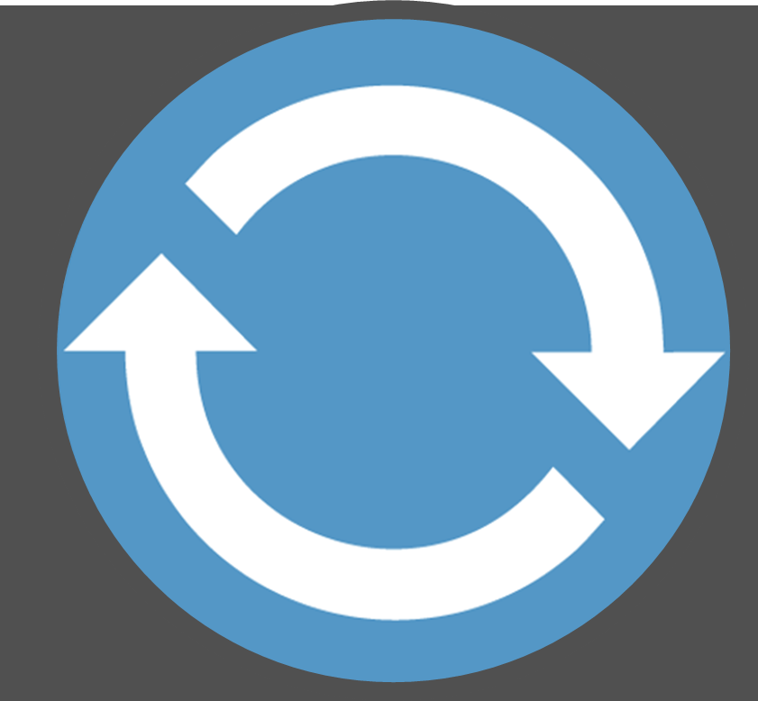
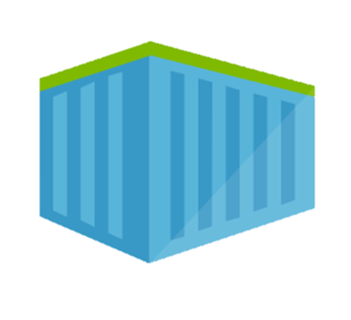
Containerized workflow
Container Service
2.
3.
4.
5.
Run, Manage
Service Fabric
Source Code Control
(SCC)
Build/CI,
Integrate,
Test
CD, Deploy
App Services
Production
environments
Common soon
Azure Container Registry
…
Push
code
…
Inner-Loop
6.
…
1.
Run
Azure Monitoring
Code
Validate
Debug
Outer-Loop
Notes:
When we look at the container continuous worfklows, we see containers and registries are a key concept.
We start with what we call the inner loop. Which is everything you do before you commit code.
From the beginning of your development cycle, you’re building and running your code in containers.
We pull base images from a container registry. Either Docker Hub, or perhaps our private corporate registry.
As we’re happy with our code, we commit the code to a source code repository.
The build system takes our code, a dockerfile that describes the build system and builds the collection of images I need for deployment
The images are pushed to our private registry, with the environment configurations extracted from the image.
When deployment happens, we pull images, add the environment information and push it out to various environments.
In Azure, we have many different container hosting offerings.
From Azure Container Service, which hosts the best of breed open source orchestrators
To Service Fabric, which can host guest containers
Or, Azure Batch, App Services for single container workloads that can scale.
And Azure continues to expand it’s container hosts as containers are becoming the unit of deployment.

Slide 79
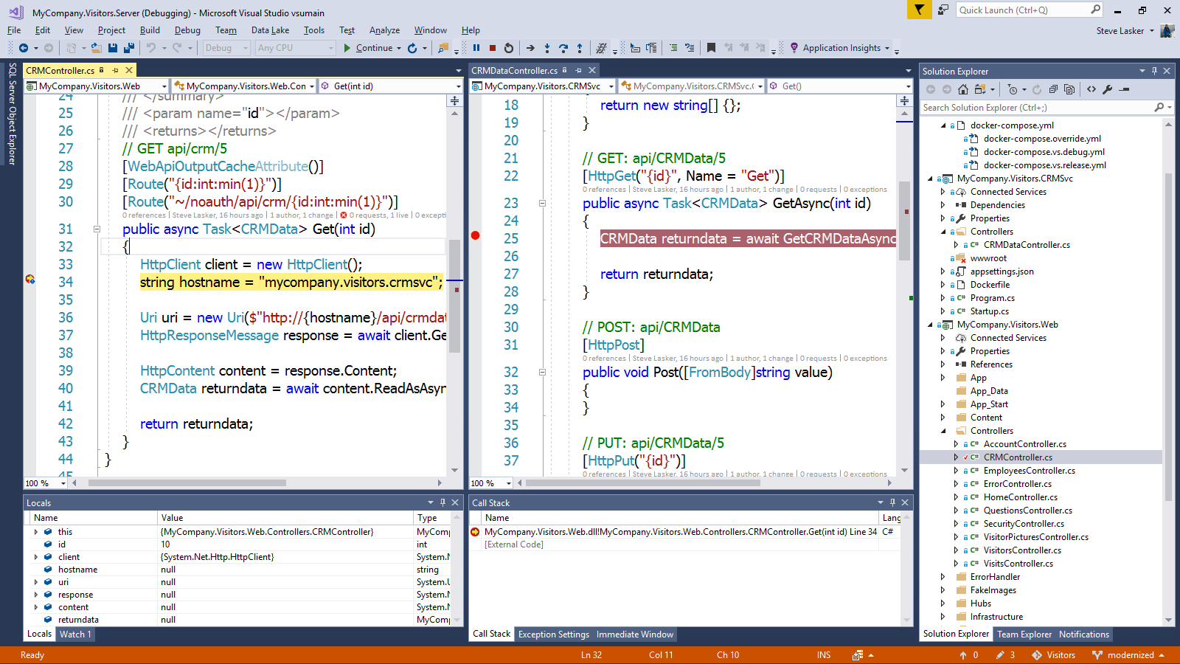
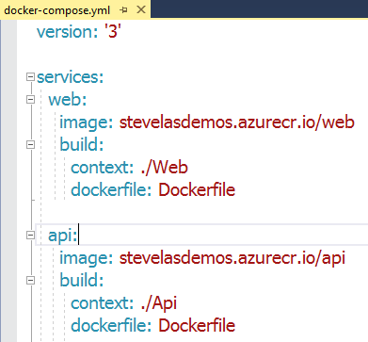
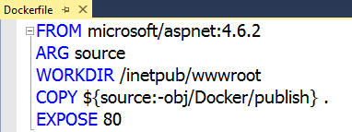
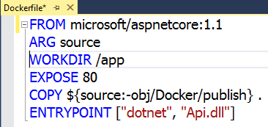
Visual Studio 2017 Container tools
Run, debug, test web, and console apps in Docker Containers
.NET FX w/Windows Server, .NET Core with Nano Server, and Linux
Breakpoint debugging
Edit & refresh of code
Scaffolds Docker assets
Dockerfile, docker-compose.yml

Slide 80
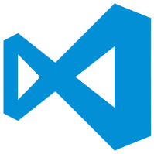
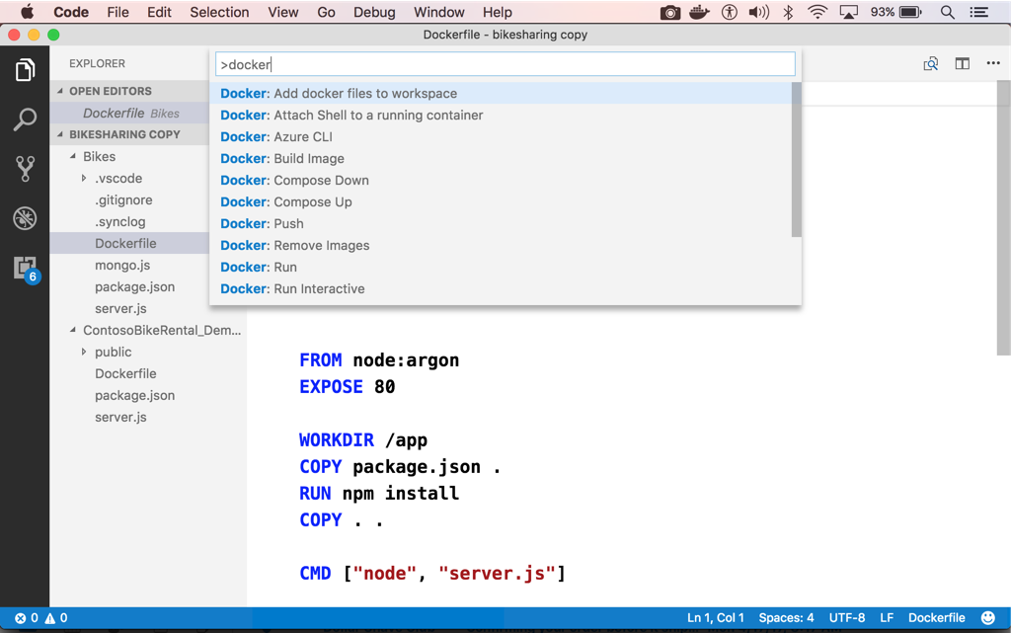
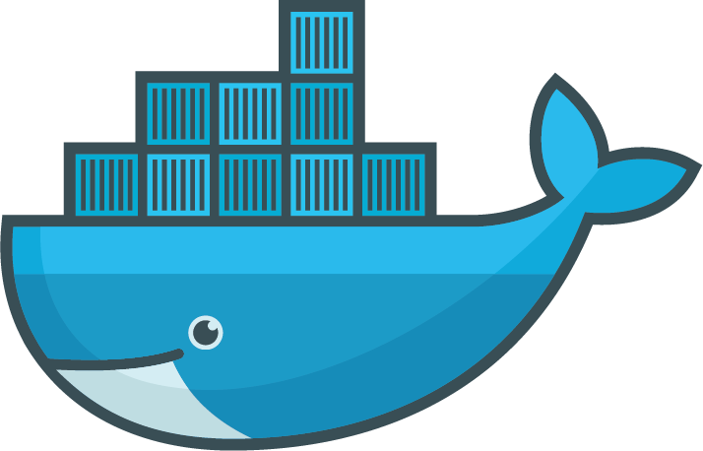
Visual Studio code
OS X, Linux, Windows
Node, Python, Go, .NET Core
Git SCC integration
Extensible platform
Docker Asset Editing – extension
aka.ms/VSCode
aka.ms/Dock`erToolsForVSCode

Slide 81
Getting Started
Containers at Microsoft
Microsoft and the container ecosystem
microsoft.com/containers
Windows Container Docs
Getting Started Guides and Documentation
aka.ms/windowscontainers
Community Links
Links to blogs, videos and other valuable resources.
aka.ms/windowscontainers/community

